Slide 1

Spotify Song’s Prediction
Group – 6 Members
Maaz Shaikh
Sahaj Khandelwal
Sujay Bhat
Warren Fernandes

Slide 2

Overview
Abstract
Dataset Insights
Data - Visualizations
Modeling
Conclusion
Inference & Predictions

Slide 3

Abstract
What factor makes the songs go hit or not on billboards?
Benefits for an artist
Benefits for the platform (Spotify)
Objectives -
Reach out to up-and-coming artists and sign exclusivity deals ahead of competition.
Work with the artists of the future popular songs on additional exclusive content such as song commentary or behind the scenes recordings.
Curate even better playlists for their current subscribers and market the platform to new subscribers using these playlists.

Slide 4

Dataset Insights
There are 19 features in total
The target column describes if the song is a hit and on the billboard’s top list or not
The rest of the important features with respect to target column
Danceability
Energy
Loudness
Key
Mode
Speechiness
Acousticness
Instrumentalness
Notes:
Danceability: It describes how suitable a track is for dancing on the basis of a combination of musical elements including tempo, rhythm stability, beat strength, and overall regularity. A value of 0.0 is the least danceable and 1.0 is the most danceable.
Energy : It represents a perceptual measure of intensity and activity
Loudness : It represents the loudness of the track
Key : Key denotes the major or minor scale in which a piece of music operates, and thus, the notes belong in it.
Mode : The category that determines whether the track is available offline or not.
Speechiness : It detects the presence of spoken words in a track, if the speechless in a song is above 0.66 it is probably made of spoken words, a score between 0.33 and 0.66 is a song that may contain both music and words, a score below 0.33 means the song does not have any speech.
Acousticness : A confidence measure from 0.0 to 1.0 off whether the track is acoustic.
Instrumentalness : A numerical, predict whether a track contains no vocals

Slide 5
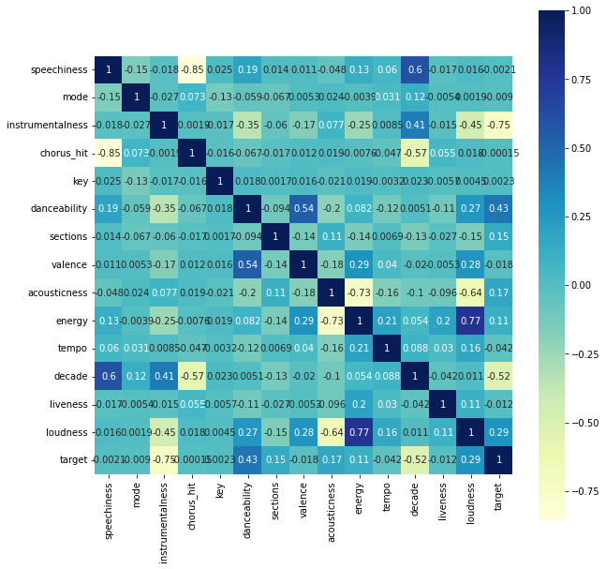
Data Processing using Correlation Matrix
Instrumental-ness
Danceability
Loudness
Acoustic-ness
Sections
Notes:
So we want to see that with respect to the target variable which feature is highly correlated or important.
Instrumentalness, Danceability, loudness, acousticness, Sections

Slide 6
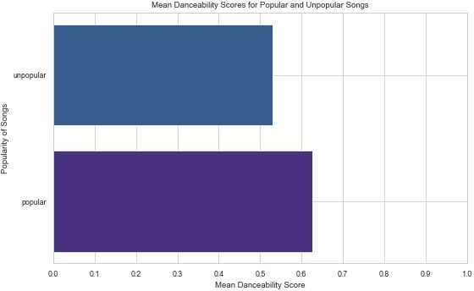
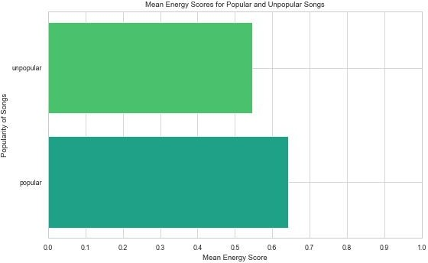
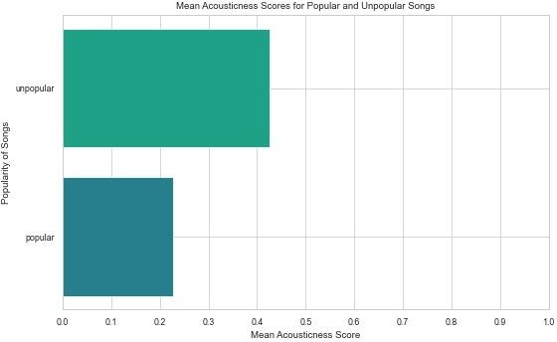
Distribution of data using different features

Slide 7
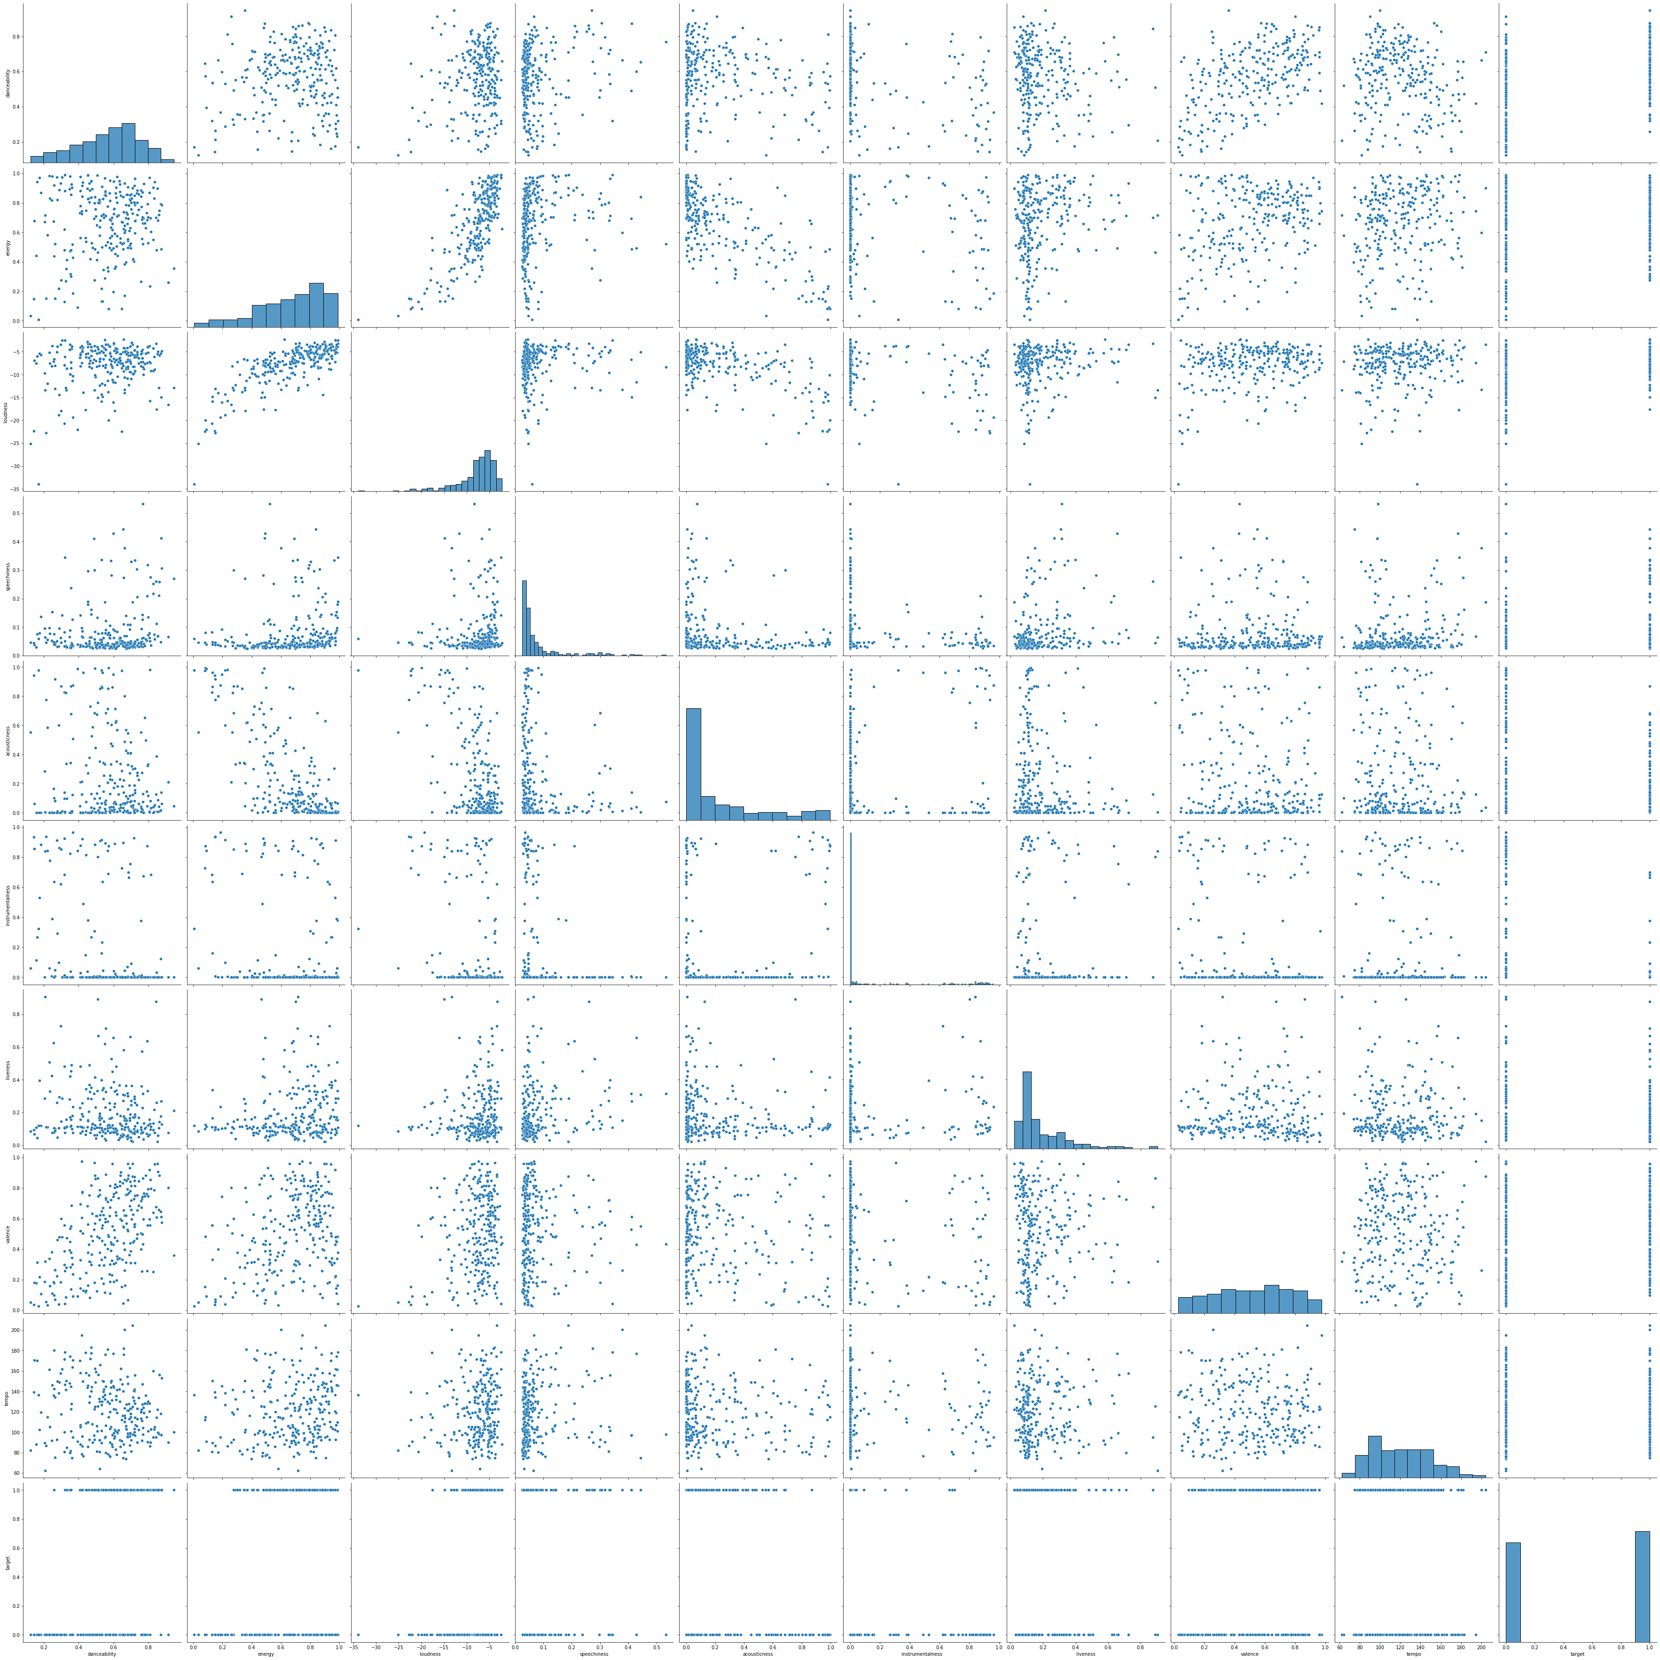
Danceability
Energy
Loudness
Speechness
Acousticness
Instrumentalness
liveliness
valence
tempo
target
Notes:
There is a complete visualization of the pair-plot,
By taking a close look at Speechiness, Loudness, Acoustic-ness, liveliness, we can see the dataset is highly skewed
While if we take a closer look at the features such as tempo, valence, etc we can see that the dataset is pretty much normal or completely balanced
While providing these features as an input we need to do some feature engineering that is removing the skewness for the model's input

Slide 8
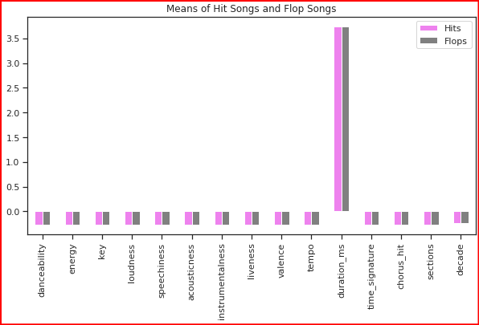
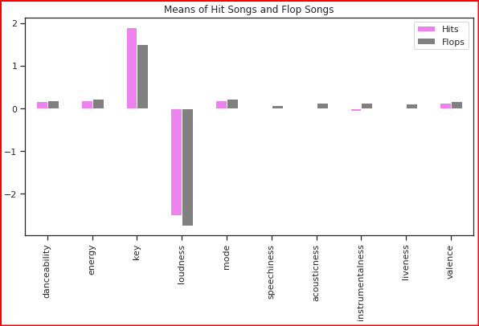
Comparison of means
Data Visualizations​
Comparison is between the hits and the flops among the features.
Notes:
If we take a close look between hit and flop songs you wont be able to tell much of a difference, the reason is that if you see duration_ms, time signature ,etc those no.s are quite high in comparision with the other factors affecting the dataset
Bifurcating the dataset for proper visualization

Slide 9
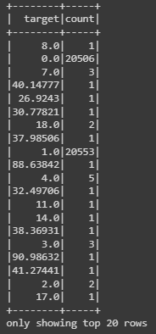
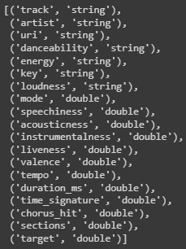
Feature Engineering
37 Garbage values in categorical column (target value)
String data type of continuous data.
Dropped NA and null values
Notes:
There were various garbage values in our target column which is supposed to have only 0 and 1.
4 of the features danceability energy key loudness were inferred as string for some reason so these had to be type casted to Double type.
There were a total of 71 null values in 4 columns. These values had to be dropped because the models can't be trained with NULL values

Slide 10
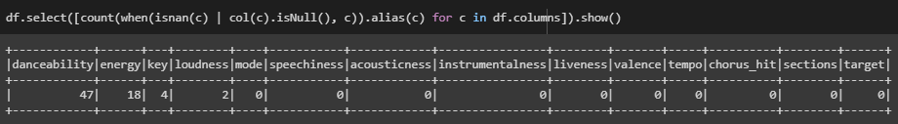
Null Values- There were a total of 71 NA/Null values in total,
Notes:
Something interesting here is that the null values only occur in features which were casted from string to numerical continuous data. Before the data was casted there were no

Slide 11
Processing and Models
We Used Logistic Regression, Random Forest, XG Boost for this classification problem
We Developed 3 Models
Logistic Regression
Random Forest
Gradient Boosting

Slide 12
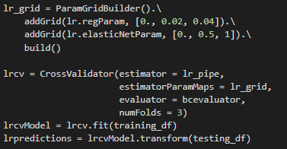
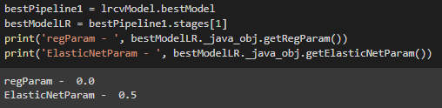
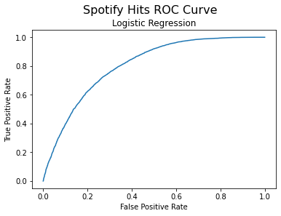
Logistic Regression
Notes:
We implemented a logistic regression model with a parameter grid. By using cross validation we didn’t have to create a validation set.
When we need to check or visualize the performance of the multi-class classification problem, we use the AUC (Area Under The Curve) ROC (Receiver Operating Characteristics) curve.
ROC is a probability curve and AUC represents the degree or measure of separability. It tells how much the model is capable of distinguishing between classes. Higher the AUC, the better the model is at predicting 0 classes as 0 and 1 classes as 1.

Slide 13
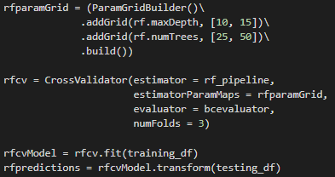
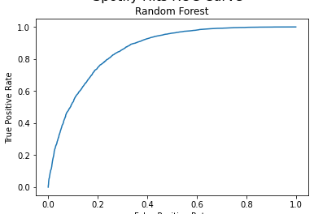

Random Forest

Slide 14
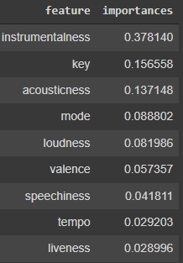
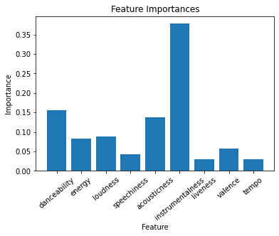
Random Forest Continued.....

Slide 15

Gradient Boosting

Slide 16
Results
Logistic Regression – AUC Score – 0.8029
Random Forest- AUC Score- 0.8581
GBT – AUC Score – 0.8980

Slide 17

Problems Encountered/ limitations
Accuracy
Does not take into consideration the other factors that could contribute to the popularity of the songs.
Less Processing Power/ Google Colab
Some Data Predi

Slide 18

Conclusion & Interesting finds
Overall, this was a very fun dataset to work with, and we are pleasantly surprised that we actually obtained fairly accurate results, especially with the logistic model.
It is quite difficult to determine if a song will be a popular or not, and there appear to be other factors at play that are not necessarily included in this dataset.
Other factors that influence if a song will be popular or not could potentially be:
Does a particular artist have any current name recognition?
Has this artist had any previous hits?
What is this artist's genre of music?
Has this artist collaborated with other popular artists?
Notes:
I assume that merging the data I have now with answers to some of the above questions would definitely allow for a much more accurate prediction of popularity scores.

Slide 19

Thank You! Any Questions?

Slide 20
Each team member's work
All of us divided the work equally amongst ourselves.
Maaz and Sujay did data visualizations and performed exploratory data analysis.
Sahaj and Warren did the model building, training, testing. Tuning the hyperparameter and finding the best hyperparameter for each model.

